Slide 1
Submissions 2: Full Applications
5 April 2011
Notes:
Submissions 2: Full Applications - <number>
Guidewire training materials contain Guidewire proprietary information that is subject to confidentiality and non-disclosure agreements. You agree to use the information in this manual solely for the purpose of training to implement Guidewire software solutions. You also agree not to disclose the information in this manual to third parties or copy this manual without prior written consent from Guidewire. Guidewire training may be given only by Guidewire employees or certified Guidewire partners under the appropriate agreement with Guidewire.

Slide 2
Lesson objectives
By the end of this lesson, you should be able to:
  Qualify submissions
  Describe how submissions vary across lines of business
  Create full applications
  Bind and issue policies
  Understand underwriting issues
  This lesson uses the notes section for additional explanation and information.
  To view the notes in PowerPoint, choose View→Normal or View→Notes Page.
  If you choose to print the notes for the lesson, be sure to select “Print hidden slides.”
Notes:
Submissions 2: Full Applications - <number>

Slide 3
Lesson outline
Full applications
Qualification and policy info
Product-specific information
Binding and issuing policies
Notes:
Submissions 2: Full Applications - <number>

Slide 4






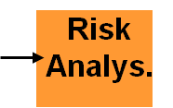


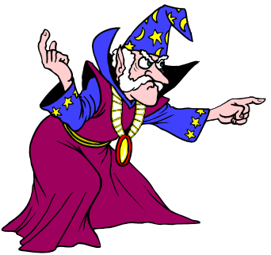
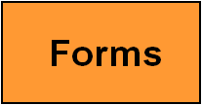
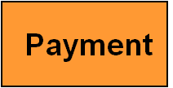
Full applications
Quick Quote Information
Quote
modify quote
Bind and
Issue
Notes:
Submissions 2: Full Applications - <number>
A full application is the complete set of information needed to issue a policy.
The Full Application submission wizard gathers the full information needed to apply for a bindable quote. There are two ways to get to the Full Application screens. You can either go to the Full Application directly from the Submission Manager, or you can first complete a quick quote and then move the information from the quick quote over to the full application. (The remaining information in the full application must still be completed.)

Slide 5
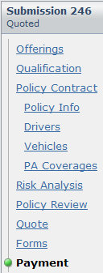
Wizard steps in full application and QQ
Two separate submission wizards
  One for quick quote
  One for full app which has more steps
Combined in Quick Quote
Info step in a QQ
Notes:
Submissions 2: Full Applications - <number>

Slide 6
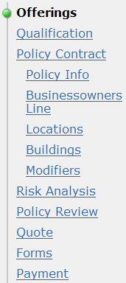
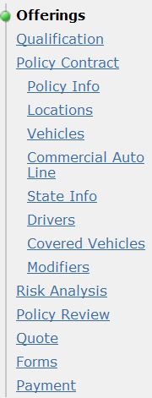
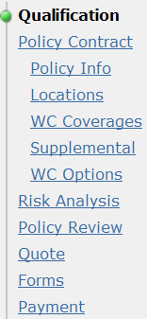
Submission wizard across products
Offer-ings
Qualifi-
cation
Policy
Info
Cove-
rages
Modi-
fiers
Risk
Analys.
Policy
Review
Full App.
Quote
Business owners
Commercial
auto
Workers’ comp
Notes:
Submissions 2: Full Applications - <number>
The submission wizard is often said to have a "sandwich-like" structure. The first and last steps are the same across all lines of business. (They are like the bread of a sandwich - remaining constant regardless of the type of sandwich). The interior steps vary dramatically depending on the line of business. They are highlighted by the red boxes above. (They are like the contents of the sandwich, which varies based on the sandwich type.)
Offerings do not appear for WC LOB but can be configured. Offering configuration is discussed in detail in the Application Configuration course.

Slide 7
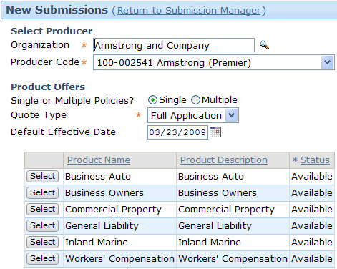

Starting a full application
From Submission Manager
From quoted quick quote
Notes:
Submissions 2: Full Applications - <number>

Slide 8
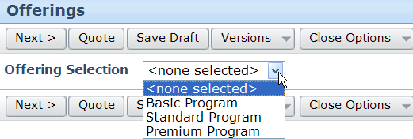
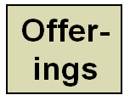
Arriving from Submission Manager or QQ
Select an offering
Notes:
An Offering lets insurers define different product types based on existing product definitions.
Submissions 2: Full Applications - <number>

Slide 9
Lesson outline
Full applications
Qualification and policy info
Product-specific information
Binding and issuing policies
Notes:
Submissions 2: Full Applications - <number>

Slide 10
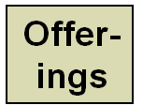

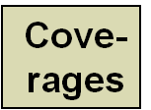
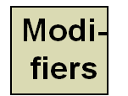
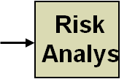
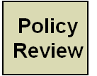
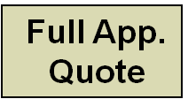
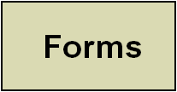
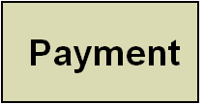
Qualification and policy info
Quick Quote Information
Quote
modify quote
Bind and
Issue
Notes:
Submissions 2: Full Applications - <number>
A producer may ask a series of qualification questions to determine eligibility. Depending on the answers, the applicant may be turned down or referred to underwriting, or may continue to the next step.
The Policy Info screen captures basic information about the primary named insured, the producer, policy details, and the selected underwriting company.

Slide 11
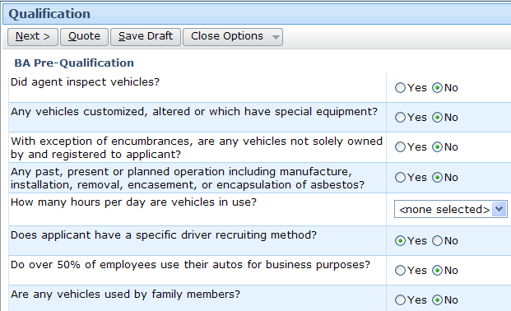
Qualification questions
Notes:
Submissions 2: Full Applications - <number>
The next step in the submission process is to answer a series of pre-qualification questions. These questions are used as an early screen for whether or not an applicant qualifies for the type of insurance being sought.

Slide 12


Filtered questions
Filtered question appears only if another question is answered with given answer
Notes:
Submissions 2: Full Applications - <number>
Each filtered question can be associated to only one other question and will be visible or not visible based on the answer to that question.
"When was the inspection?" is a filtered question that appears only if the "Did agent inspect vehicles?" question is answered with yes.

Slide 13
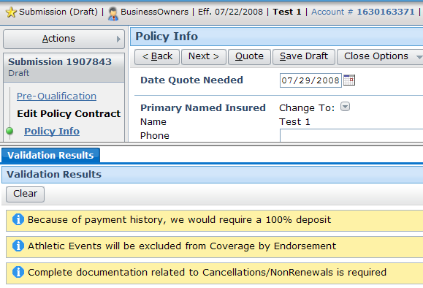
Qualifying with issues
Answers to qualification questions can also be used to raise issues which may affect submission processing
Notes:
Submissions 2: Full Applications - <number>
Some of the answers may be a cause for concern, but by themselves they do not justify preventing qualification. In these cases, the application creates an underwriting issue to record the concern. (An underwriting issue is a record that identifies risk information relevant to a submission or renewal. Underwriting issues are discussed later in this lesson.)
Issues raised as the result of pre-qualification questions could:
Increase the quote amount
Cause the submission to be declined (if a number of high risk issues develop during the course of the submission)

Slide 14
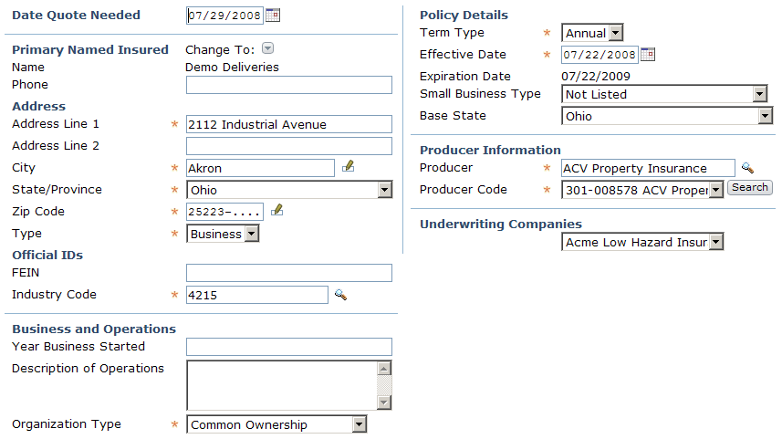
Policy info
Policy details
Producer
Insured
Notes:
Submissions 2: Full Applications - <number>
Underwriting companies are discussed on the next slide.

Slide 15
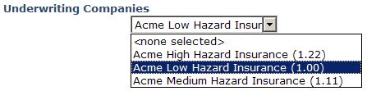
Underwriting companies
Submission associated to one underwriting company
  These are shell companies owned by carrier with differing rates
Notes:
Submissions 2: Full Applications - <number>
Large carriers typically have multiple subsidiaries licensed to underwrite policies on behalf of the carrier. This is to accommodate state regulatory requirements. Many states do not allow carriers to have more than one set of rates per underwriting company. Therefore, if a carrier wants to offer multiple sets of rates in that state, they must file each set under a separate underwriting company for that state.
Underwriters often profile an account to determine what segment an account falls into and therefore which underwriting company would actually underwrite the policy and by extension which set of rates the account is eligible for. The appropriate set of rates would then be used to quote the policy. For example, a workers' compensation carrier may segment accounts into three different segments: high hazard, medium hazard or low hazard. The carrier has three underwriting companies that correspond to each segment. To generate a quote for the policy, an underwriter would then indicate which underwriting company the policy should be placed with. This information is then fed into the rating engine so that the rating engine can calculate a quote for the policy with the appropriate set of rates.
When a producer initiates a submission, the selected underwriting company is typically selected via rules. An underwriter is typically given the authority to change the underwriting company. The available underwriting companies can be filtered based on rules. If the underwriter is under pressure to retain the business by lowering the premium, they may be able to evaluate the insured into a more favorable underwriting company with lower rates.
In some cases, the relative rates of each underwriting company may be based upon a simple factor. If so, the relative rates of each underwriting company are indicated by the decimal values that follow the company name. The currently selected company has a value of "(1.00)". If the trailing value for an underwriting company is less than 1.00, then the use of that underwriting company will lower the policy rates. If the trailing value for an underwriting company is greater than 1.00, then the use of that underwriting company will raise the policy rates. (In the example above, the selected underwriting company is Acme Low Hazard Insurance. If the submission is switched to Acme Medium Hazard Insurance, then the rates will increase by 11%. (1.11 is 11% greater than 1.00.) If the submission is switched to Acme High Hazard Insurance, then the rates will increase by 22%.

Slide 16
Lesson outline
Full applications
Qualification and policy info
Product-specific information
Binding and issuing policies
Notes:
Submissions 2: Full Applications - <number>

Slide 17
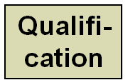



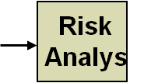
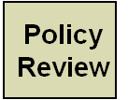
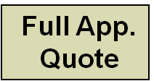
Coverages and modifiers
Quick Quote Information
Quote
modify quote
Bind and
Issue
Forms
Payment
Notes:
Submissions 2: Full Applications - <number>
The "Coverages" step listed above collectively refers to a large number of screens which vary across lines of business.
The Modifiers screen is not available for every line of business. When it is available, it is still possible that the product does not have any modifiers (depending on the base state of the policy and/or the coverages selected).

Slide 18
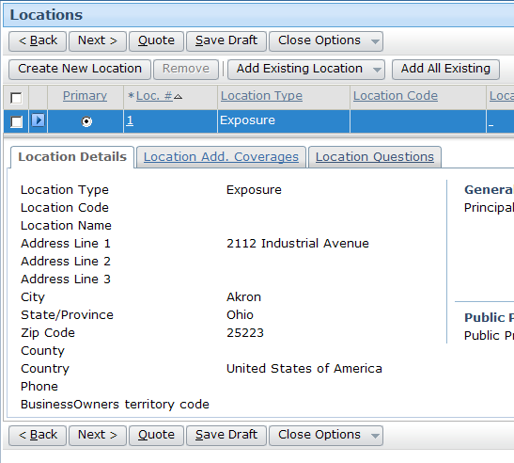
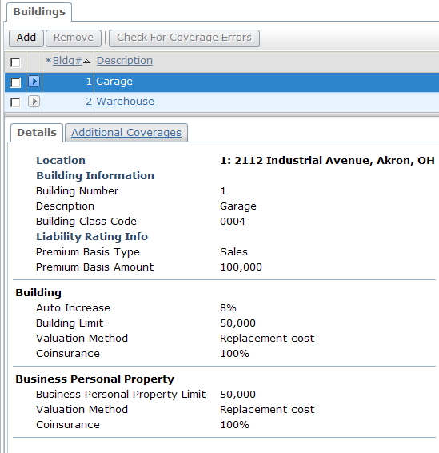
Coverage example: Business owners
Coverage functionality discussed in detail in Product Model section
Notes:
Submissions 2: Full Applications - <number>

Slide 19
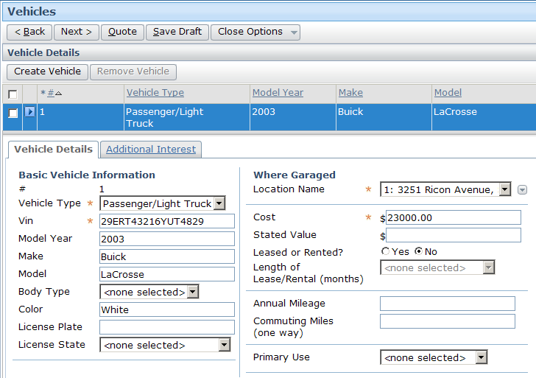
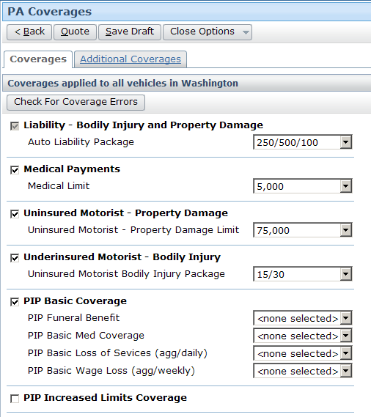
Coverage example: Personal auto
Coverage functionality discussed in detail in Product Model section
Notes:
Submissions 2: Full Applications - <number>

Slide 20
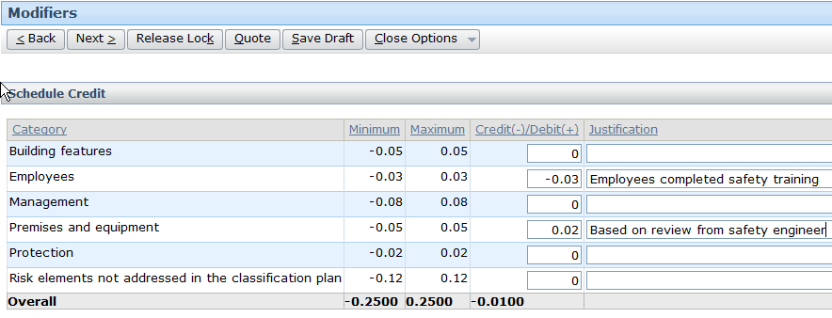
Modifiers
Modifiers decrease (credit) or increase (debit) policy premium by given factor
  Input must be within specified range
  If input is non-zero, justification must be provided
Notes:
Submissions 2: Full Applications - <number>
Modifiers are discussed in detail in the Modifiers lesson.

Slide 21
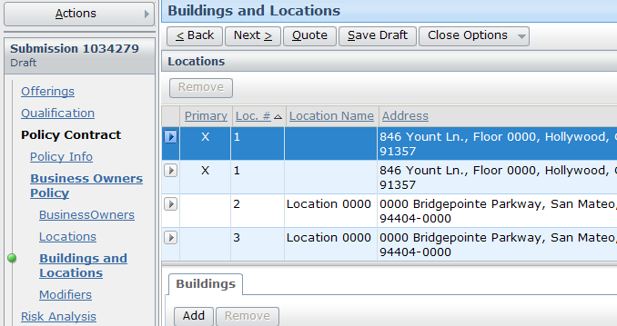
Entering full application policy data
Notes:
Submissions 2: Full Applications - <number>
Just as is the case in a quick quote, the coverable and coverage information for the policy must be entered into a full application (if not already carried over from a quick quote). Aside from the amount of information to enter, there is no significant difference between quick quotes and full applications.
Like quick quotes:
The specific wizard steps, screens, and fields for coverables and coverages vary dramatically from one line of business to the next.
In the navigation bar, the screens are listed in a particular order, but once the required information on the first screen has been specified, the user can fill out the remaining information in any order.
If a user needs more information about the fields in the wizard (such as what types of vehicles are "special" vehicles or what is covered in the "Business Auto Loan Lease Gap Group"), then he or she should refer to documentation outside of PolicyCenter. This type of information is typically captured in some sort of underwriting manual.

Slide 22
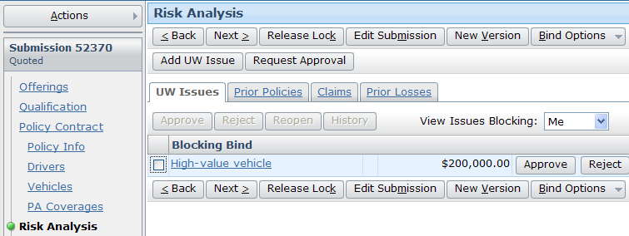
Risk Analysis
Summarizes issues relevant to sizing risk
Notes:
Submissions 2: Full Applications - <number>
Underwriting issues are explained in the next three slides in short and are discussed in detail later in this course in the Underwriting Authority lesson.

Slide 23


Underwriting issues
An underwriting issue is created when a condition evaluated, based on data in PolicyCenter, gives undesirable result(s)
Submission could be rejected (either by underwriter or business rules) based on:
  Kinds and severity of UW Issues
  Combination of issues
  Other information or judgment of the underwriter
UW issue
UW issue
UW issue
Notes:
Submissions 2: Full Applications - <number>
All the jobs in the base application make use of underwriting issues except cancellation and audit. Only users with proper authority profile can approve these issues. Authority profiles determine the types of underwriting issues that a user can approve. You can assign authority profiles to users. Each authority profile contains one or more authority grants which grant levels of approval, often for a specific underwriting issue and within certain limits. Authority grants are similar to physical letters of authority.

Slide 24
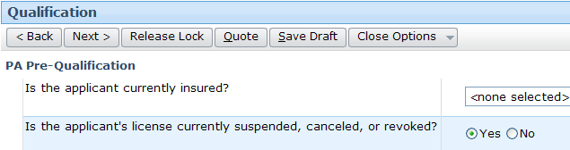
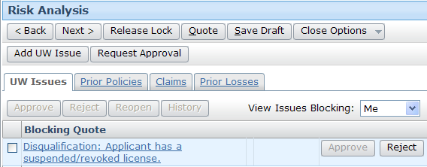
Qualification questions can raise UW issues
Questions answered incorrectly can raise UW issues
Notes:
Submissions 2: Full Applications - <number>
Agents can approve issues related to their ability to quote or bind if they have the appropriate authority. If they don’t, then they Request Approval from an underwriter. Consider the example in the screenshot above, the agent creating the submission has the Approve button grayed for the Blocking Quote issue: Applicant has a suspended/revoked license. Hence the agent will click the Request Approval button and the work order is sent to the underwriter for review.
Answering qualification questions
• The applicant answers the questions correctly. The submission process continues normally.
• The applicant answers some of the questions incorrectly. Incorrect answers can raise underwriting issues which an underwriter needs to review. In the default configuration, underwriting issues are raised before quoting the policy.
• The underwriter reviews the underwriting issues and approves them. The agent can quote the policy and continue the submission.
• The underwriter decides that the applicant does not meet the base requirements, and declines the underwriting issues. The agent cannot quote the policy. The agent can revise the qualification questions and other parts of the policy. These changes may remove underwriting issues blocking the submission.
Configuration users can configure the error message that appears when the applicant answers a question undesirably. In some cases, the carrier wants the message to be as explicit as possible so that agents know exactly what the eligibility requirements are. In other cases, they want the answer to be less straightforward to prevent users for knowing how to beat the system and qualify an undesirable applicant.

Slide 25
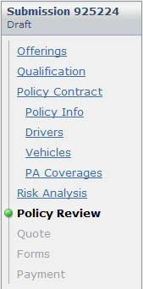
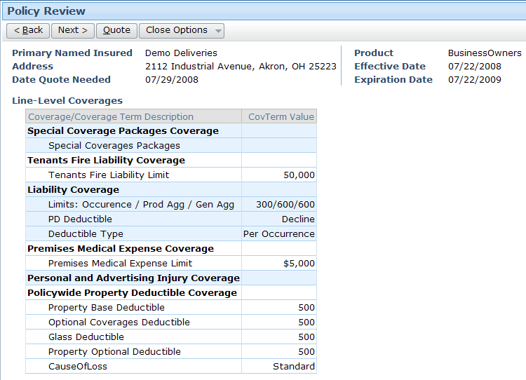
Policy Review
Policy Review summarizes entire policy
Notes:
Submissions 2: Full Applications - <number>

Slide 26

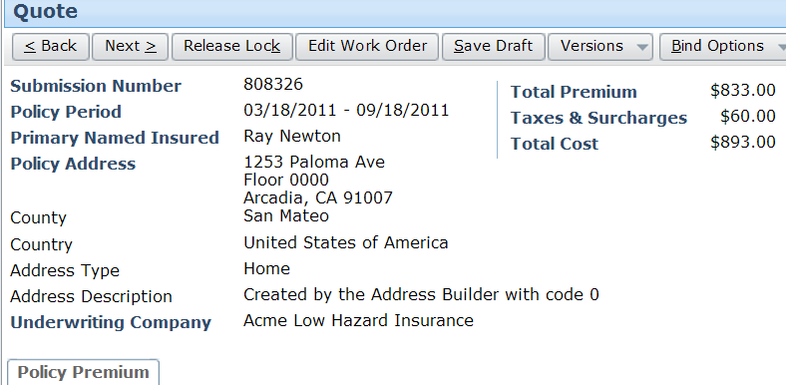
Quoting a full application
Similar to quick quotes:
  Validation is run before submission is quoted
  Quote is explained in detail on Quote step
  Multiple versions can be created for quote comparisons
Notes:
Submissions 2: Full Applications - <number>
To generate the first quote, the user simply clicks the "Quote" button.
Just like quick quotes, bindable quotes are generated by taking the information supplied (exposures, coverages, and coverage terms) and sending it to a rating engine. The rating engine uses the information to calculate what the premium will be. In some cases, the calculation can be complex (such as when the calculation involves an uninsured motorist coverage which may have a premium that varies based on number of cars in the fleet, deductible, zip code of the garage, requirements of the state in which the car is garaged, type of vehicles, vehicle usage, accident history of the drivers involved, and so on.)
The quote is broken down into smaller line items.
The "Edit Submission" button lets you edit the current draft. The "New Version" button creates a copy of the current version of the draft. Edits made after clicking the "New Version" button do not affect the original draft, whereas edits made after clicking the "Edit Submission" button do affect the original draft.

Slide 27
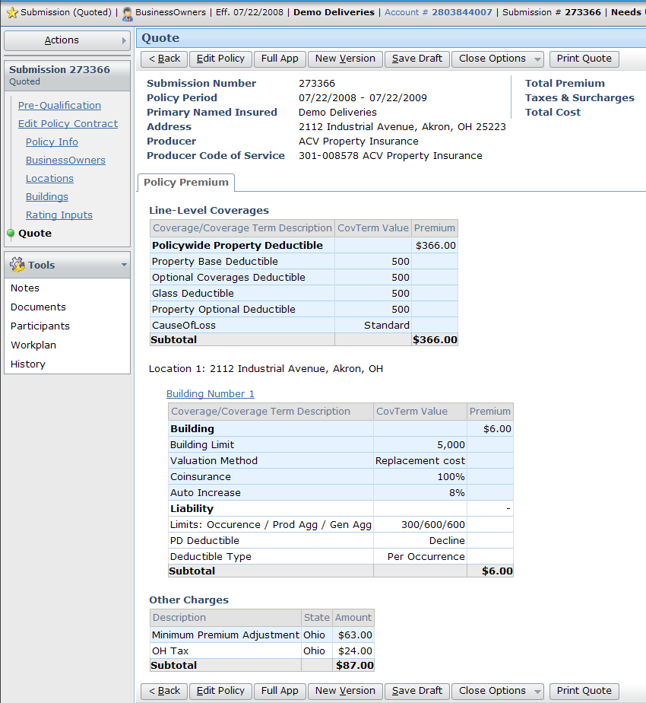
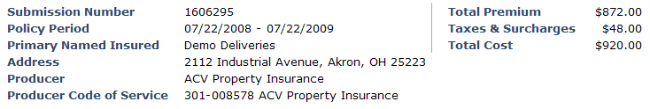
Quote and quote details
Notes:
Submissions 2: Full Applications - <number>
To generate the first quote, the user simply clicks the "Quote" button.
Quotes are generated by taking the information supplied (coverables, coverages, and coverage terms) and sending it to a rating engine. The rating engine uses the information to calculate what the premium will be. In some cases, the calculation can be complex (such as when the calculation involves an uninsured motorist coverage which may have a premium that varies based on number of cars in the fleet, deductible, zip code of the garage, requirements of the state in which the car is garaged, type of vehicles, vehicle usage, accident history of the drivers involved, and so on.)
The quote is broken down into smaller line items.
The Quote screen typically lists all the coverables on the policy, all the coverages, and a line-by-line description of how the premium was calculated. The example shown above is relatively simple, as it involves a single exposure and a single state, but the breakdown can be very complex when multiple exposures and states are involved.

Slide 28
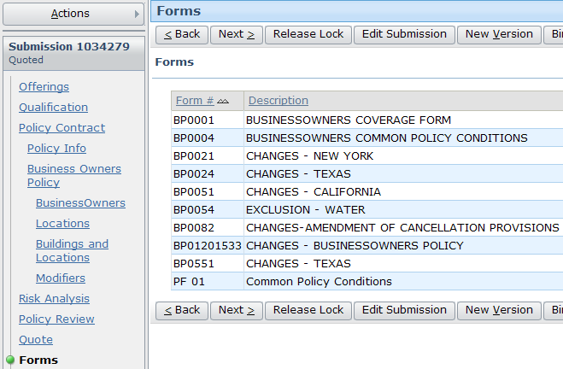
Forms
Any forms added to submission are listed on Forms step
Notes:
Submissions 2: Full Applications - <number>
Forms are discussed in detail later in this course.

Slide 29
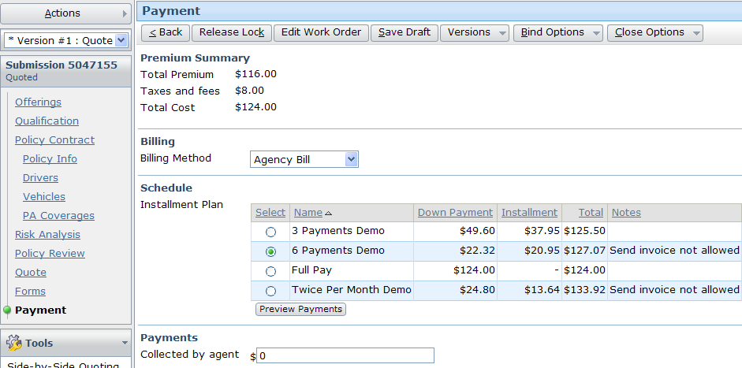
Payment
Before policy can be bound, underwriter must supply billing plan and payment plan on Payment screen
Notes:
Submissions 2: Full Applications - <number>
The Payment screen identifies information that must be sent to the billing system once the policy is bound.

Slide 30
Lesson outline
Full applications
Qualification and policy info
Product-specific information
Binding and issuing policies
Notes:
Submissions 2: Full Applications - <number>

Slide 31
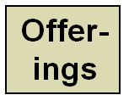
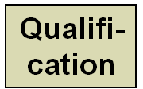

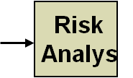
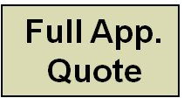

Full applications
Quick Quote Information
Quote
modify quote
Forms
Payment
Notes:
Submissions 2: Full Applications - <number>
When a policy is bound, it becomes a legal contract.
The final section of the submission job wizard is the Binding & Issue section. The only way to get to this section is after a full application has been completed and a bindable quote has been generated. (You cannot bind a policy using only a quick quote.)

Slide 32



Bind options
Bind Only - policy is legally binding, but no information sent to billing or issuance system
Issue Policy - policy is legally binding, data sent to billing and issuance/printing system
Notes:
Submissions 2: Full Applications - <number>
The majority of the time, underwriters who are ready to complete the submission job select the "Issue Policy" menu item. This is discussed on the next few slides.
The "Bind Only" menu item binds the policy (which means the policy is now a legal contract and the applicant is insured). However, it does not send information to the billing system (which means no bills we be sent to the insured at this point), and it does not send information to the print/issuance system (which means no documents are printed at this point.) The "Bind Only" option is relevant when the insured and carrier agree to the general contract, but there is still information to collect before documents can be printed (such as the street addresses of all the building covered in a business owner's policy), and this information could result in a material change to the policy (such as the discovery that a building is in a zip code which is consider riskier and this causes an increase in the policy premium). Once the information is complete, the end user can search for the bound policy. There is an "Issue Submission" link, which the end user can use to promote the policy to issued status.

Slide 33
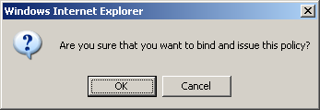
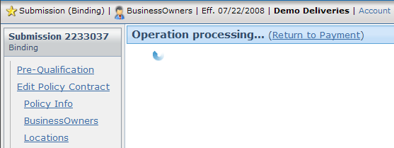
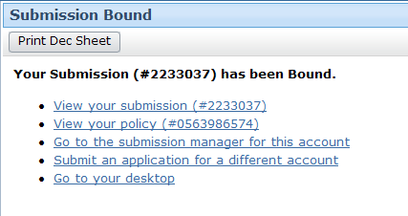
Binding and issuing a policy
Notes:
Submissions 2: Full Applications - <number>
When the "Issue" menu item is selected:
Information is sent to the billing system so that billing can commence.
Information is sent to the print/issuance system so that the physical documents can be issued (printed and sent to the insured).
In the base application, selecting the "Issue Policy" menu link results in the binding of the policy. In a real implementation of PolicyCenter, other business steps may occur after the "Issue Policy" menu item is selected but before the policy is actually bound. For example, business logic may evaluate the policy and determine that additional approval is needed before the policy can be bound.
Once the policy is bound, a policy number is generated. The status of the submission changes to "Issued".

Slide 34
Lesson objectives review
You should now be able to:
  Qualify submissions
  Describe how submissions vary across lines of business
  Create full applications
  Bind and issue policies
  Understand underwriting issues
Notes:
Submissions 2: Full Applications - <number>

Slide 35
Review questions
Name three differences between a quick quote and a full application.
What is the difference between a full application that is started from a quick quote and a full application that is started directly from Submission Manager.
If an applicant answers a Qualification question unfavorably, how will PolicyCenter react?
What is the purpose of an UW issue?
What is a blocking point?
Notes:
Submissions 2: Full Applications - <number>
Answers
Possible answers:
- Typically, quick quotes have fewer steps and involve screens with fewer fields.
- Quick quote information can be carried over to a full application (but not vice versa).
- Once you have generated a full application quote, you cannot generate a quick quote. (But, generating a quick quote does not prevent you from being able to generate full application quotes.)
- There are two entry points for Full Applications (Submission Manager and the Quick Quote payment screen). There is only one entry point for Quick Quotes (Submission Manager).
A full application from a quick quote has all the information entered on the quick quote pages. A full application from Submission Manager has no information in it.
The applicant could be Qualified with issues, which could later impact their ability to get the policy or their rates.
An UW issue is designed to collect risk information about the submission. This information could cause the submission to be processed differently (for example, if applicant’s information raises UW issues that the agent cannot approve, they are sent to and underwriter for review.)
Blocking point is the point at which an issue blocks progress of a job.

Slide 36
Notices
Copyright © 2001-2011 Guidewire Software, Inc. All Rights Reserved.
Guidewire, Guidewire Software, Guidewire ClaimCenter, Guidewire PolicyCenter, Guidewire BillingCenter, Guidewire Reinsurance Management, Guidewire ContactManager, Guidewire Vendor Data Management, Guidewire Client Data Management, Guidewire InsuranceSuite, Guidewire ContactCenter, Guidewire Studio, Gosu, Deliver Insurance Your Way, and the Guidewire logo are trademarks or registered trademarks of Guidewire Software, Inc. in the United States and/or other countries.
This material is Guidewire proprietary and confidential. The contents of this material, including product architecture details and APIs, are considered confidential and are fully protected by customer licensing confidentiality agreements and signed Non-Disclosure Agreements (NDAs).
This file and the contents herein are the property of Guidewire Software, Inc. Use of this course material is restricted to students officially registered in this specific Guidewire-instructed course, or for other use expressly authorized by Guidewire. Replication or distribution of this course material in electronic, paper, or other format is prohibited without express permission from Guidewire.
    Guidewire products are protected by one or more of the following patents: U.S. Patent No. 7,885,831; U.S. Patent No. 7,788,296.
Notes:
Introduction to Guidewire Configuration - <number>

